Slide 1

DS 680 Marketing Analytics & Operational Research

Slide 2

AGENDA
COMPANY -VISION AND MOTTO
INTRODUCTION
EVOLUTION
STRATEGIES
TARGET MARKET
METHODOLOGY
CONCLUSION

Slide 3

Vision
Netflix's vision is to become the world's leading streaming entertainment service, providing a diverse range of high-quality content that entertains and inspires audiences globally.
Motto
"See What’s Next."
This motto reflects Netflix's commitment to innovation and its focus on delivering new and engaging content to its subscribers.

Slide 4
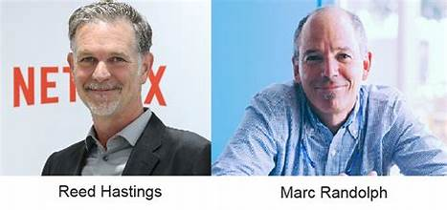
INTRODUCTION
Netflix, Inc. is a leading American streaming service founded in 1997 by Reed Hastings and Marc Randolph. Originally a DVD rental service, Netflix has evolved into a global platform offering a vast library of movies, TV shows, and original content. With over 230 million subscribers worldwide, it has revolutionized the way people consume entertainment, popularizing binge-watching and investing heavily in diverse programming to cater to audiences around the globe.

Slide 5
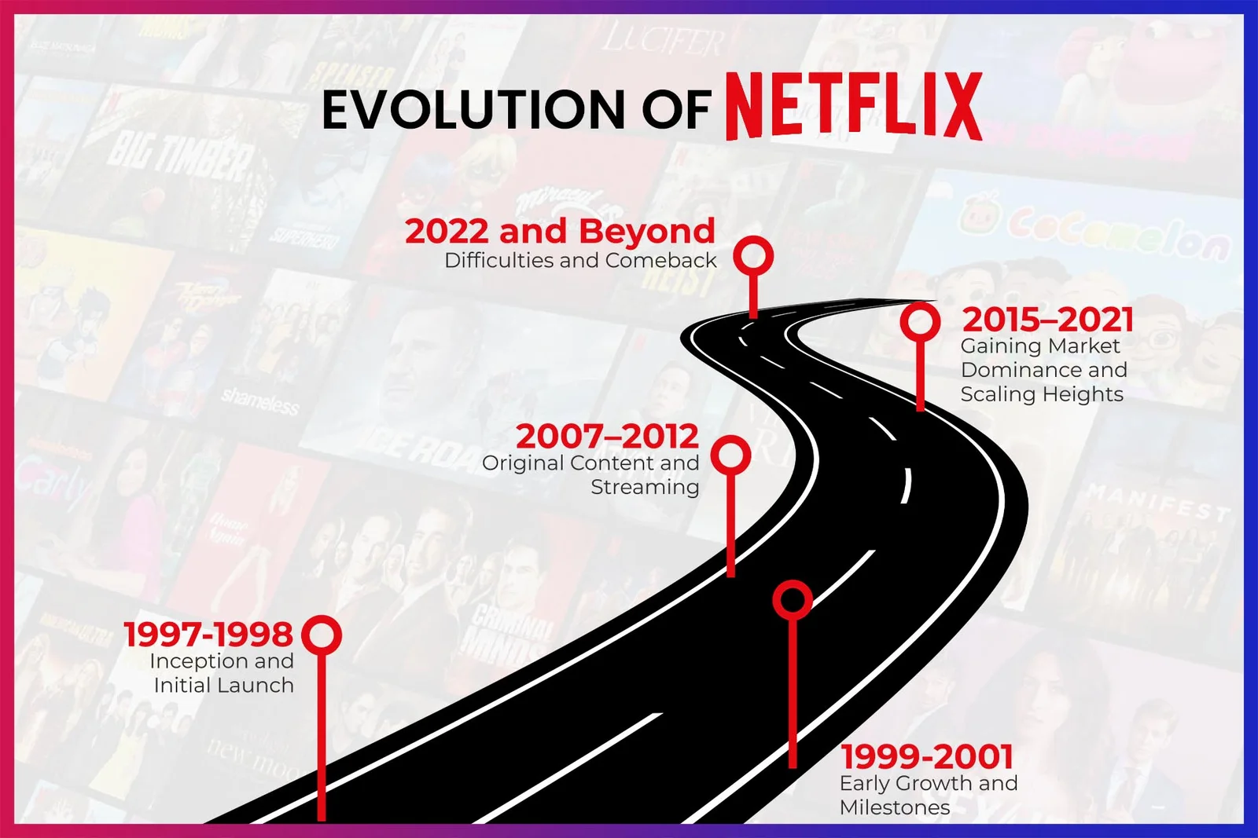
EVOLUTION
1997 - Founding: Netflix was founded by Reed Hastings and Marc Randolph as a DVD rental service, allowing customers to rent DVDs online and have them mailed to their homes.
2000 - Subscription Model: Netflix introduced a subscription model, allowing customers to rent unlimited DVDs for a monthly fee without late fees, which was a significant shift from traditional rental stores.
2007 - Streaming Service Launch: Netflix launched its streaming service, enabling subscribers to watch movies and TV shows instantly online. This marked the beginning of its transition from DVD rentals to digital streaming.
2010 - International Expansion: Netflix expanded its streaming service internationally, starting with Canada and gradually reaching other countries, including the UK and Latin America.

Slide 6
EVOLUTION
2013 - Original Content: Netflix began producing its own original content, starting with the critically acclaimed series "House of Cards." This move allowed Netflix to differentiate itself from competitors and attract more subscribers.
2016 - Global Reach: Netflix became available in over 190 countries, solidifying its position as a global streaming leader.
2020 - Continued Growth: The COVID-19 pandemic led to a surge in subscribers as more people turned to streaming for entertainment during lockdowns.
Present - Ongoing Innovation: Netflix continues to invest in original programming, explore interactive content, and enhance user experience through technology and personalized recommendations.
This evolution has transformed Netflix into a dominant player in the entertainment industry, shaping how audiences consume content today.

Slide 7

STRATEGIES
Content Diversity: Netflix invests in a wide range of content, including original series, films, documentaries, and international programming to appeal to various audiences.
Data Analytics: The company uses data-driven insights to understand viewer preferences and trends, guiding content creation and acquisition decisions.
User Experience: Netflix focuses on providing a seamless user experience with personalized recommendations, an intuitive interface, and high-quality streaming.
Global Expansion: Netflix actively expands into international markets, offering localized content to cater to different cultures and languages.
Original Programming: By producing exclusive original content, Netflix differentiates itself from competitors and builds a loyal subscriber base.

Slide 8


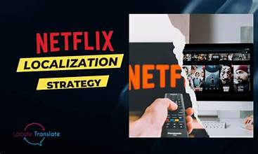
TARGET MARKET
Young Adults and Millennials: This demographic is tech-savvy and prefers on-demand content.
Families: Netflix offers a variety of family-friendly programming and kids' content.
International Markets: With localized content, Netflix aims to cater to different cultures and languages, expanding its reach in various countries.

Slide 9


METHODOLOGY
Data-Driven Decision Making: Netflix utilizes extensive data analytics to track viewer behavior, preferences, and engagement metrics. This data informs content creation, acquisition, and marketing strategies.
Original Content Production: The company invests in producing original series, films, and documentaries to differentiate itself from competitors and build a unique brand identity.
Global Expansion: Netflix continuously explores new markets and tailors its content offerings to meet local tastes and preferences, ensuring relevance in diverse regions.
User Experience Focus: The platform prioritizes a seamless user experience, optimizing streaming quality, interface design, and personalized recommendations to enhance viewer satisfaction.

Slide 10

CONCLUSION
In conclusion, Netflix has transformed the entertainment landscape through its innovative approach to content delivery and consumption. By leveraging data analytics, investing in diverse and original programming, and focusing on user experience, Netflix has successfully attracted a global audience and established itself as a leader in the streaming industry. Its commitment to continuous improvement and adaptation to changing viewer preferences positions it well for future growth. As it navigates challenges such as increased competition and evolving market dynamics, Netflix remains dedicated to providing high-quality entertainment that resonates with audiences worldwide.

Slide 11

Harshitha Durgam Spirit ID: 1055115
Sri Satya Surya Teja Gadde Spirit ID: 1044167

